Slide 1
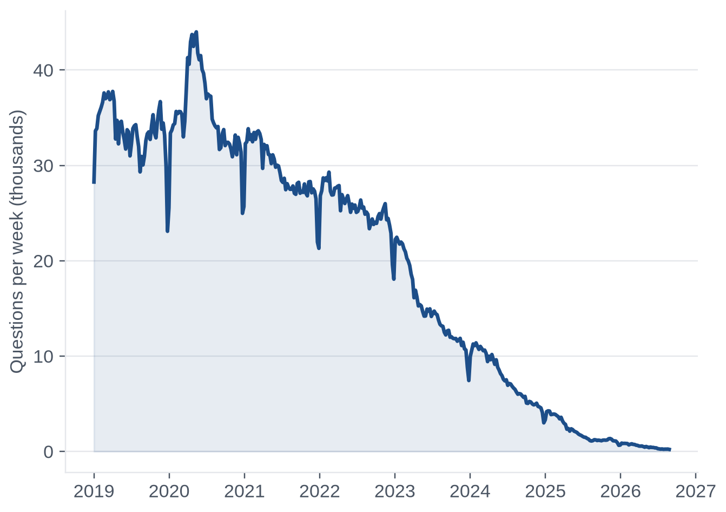
TEAM 7 · 23CSE452 BUSINESS ANALYTICS · REVIEW 1
Which Stack Overflow questions still get an answer in the age of AI?
A prediction study on 309,179 questions, 2019 to 2026
Adhikkesh S K CB.SC.U4CSE23101
Abhinav Gopalakrishnan CB.SC.U4CSE23201
Rishiikesh CB.SC.U4CSE23236
Akshay Krishna CB.SC.U4CSE23403
Nishanth Konchada CB.SC.U4CSE23523
Questions per week on Stack Overflow, 2019 to 2026 (complete counts from the Stack Exchange API)
Notes:
Good morning. We are Team 7. Our project asks one practical question about Stack Overflow in the age of AI coding assistants: can we tell, when a question is posted, whether it will get an accepted answer within a week?

Slide 2
01 / THE PLAN
Five stages, one pipeline, one question
01
Collect
309,179 questions pulled from the Stack Exchange API, across 13 tags.
The question
02
Clean
Will a newly posted question get an accepted answer within 7 days?
If we can tell early, a forum team can send the hardest questions to an expert first.
We also look at what changed after ChatGPT launched, without claiming it was the cause.
302,026 clean rows, each with two 7-day outcomes.
03
Explore
What the data says about resolution before and after late 2022.
04
Prepare
A time-based split, features that cannot leak, and a baseline.
05
Predict
Stronger models, tested once on the newest period.
Order of the talk: the problem, the data, what the data shows, then the models.
Stack Overflow in the AI Era
2
Notes:
Our work follows the data: collect it, clean it, explore it, prepare features and a baseline, then build and test the stronger models. We present the problem first, then the data, what the data shows, and the models.

Slide 3
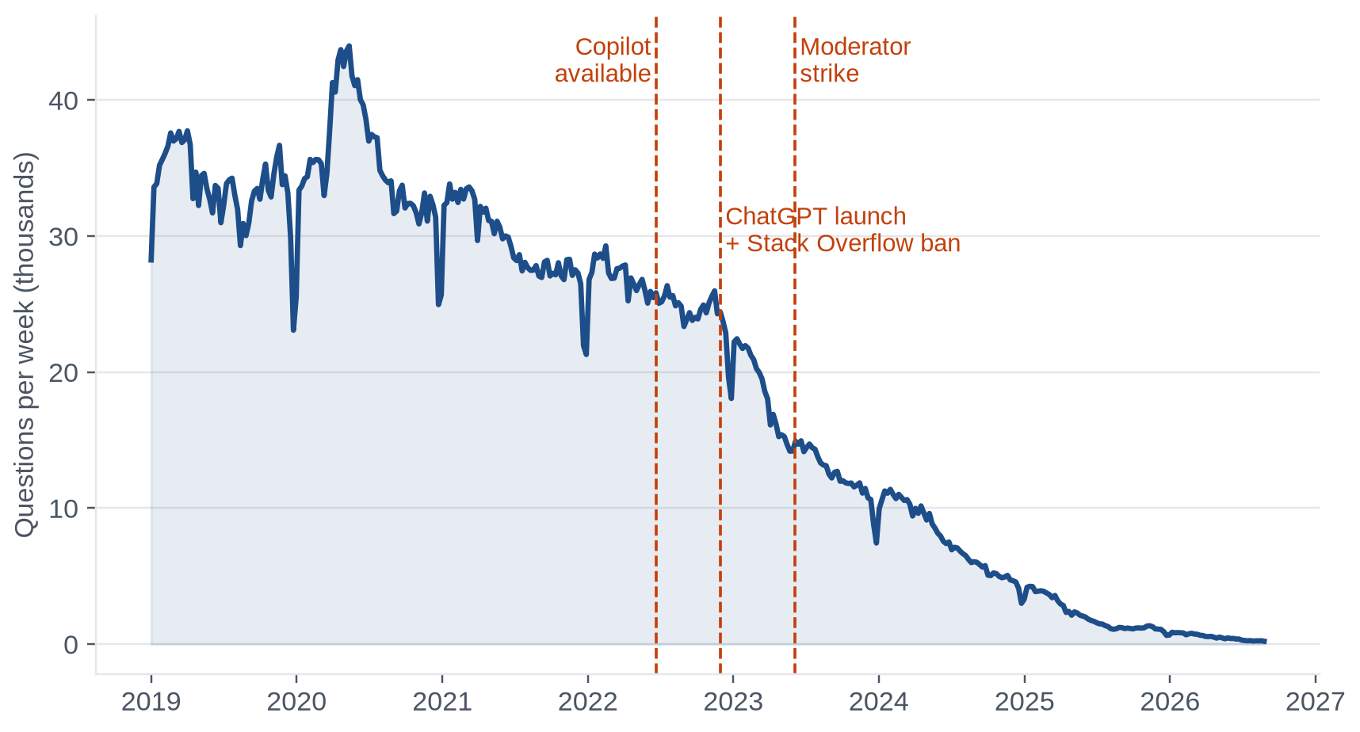
01 / THE PROBLEM
Stack Overflow lost about nine in ten questions in three years
Questions per week, 2019 to 2026
1.34M → 109K
questions a year, 2022 vs 2025
A fall of 92%, checked against Stack Exchange Data Explorer.
Four events sit around the break
Jun 2022 GitHub Copilot opens to all developers
30 Nov 2022 ChatGPT launches
Dec 2022 Stack Overflow bans ChatGPT answers
Jun 2023 Moderators go on strike
What it means: the timing fits the arrival of AI tools, but we only describe timing. We do not claim cause.
Stack Overflow in the AI Era
3
Notes:
Stack Overflow used to be where every developer went with a question. Checked against the Stack Exchange Data Explorer, the site received about 1.3 million questions in 2022 and about 109 thousand in 2025. The fall starts around the time Copilot became available and ChatGPT launched. We describe the timing of events; we do not claim they caused it.

Slide 4
01 / THE PROBLEM
So we asked: will a new question get an accepted answer?
The problem
The prediction
Who would use it
Activity on developer Q&A sites has dropped since AI coding assistants spread.
Managers cannot see which questions still need a human expert, or which are likely to go unanswered.
We study how resolution changed and whether we can predict it.
Main outcome: an accepted answer within 7 days. 41% of questions get one.
Check outcome: any answer within 7 days. 75% do.
One rule: only what is known when the question is posted may be used.
Forum managers send risky questions to experts.
Product teams track how resolution shifts.
Developer relations teams see which technologies lose community help.
Our research question: which question characteristics predict an accepted answer within 7 days, and how did resolution change around November 2022?
Stack Overflow in the AI Era
4
Notes:
A forum manager cannot read every new question. If we can estimate which ones are likely to stay unresolved, experts can look at those first. We predict whether a question gets an accepted answer within seven days, and we check our conclusions against a second, easier outcome: any answer within seven days.

Slide 5
02 / DATA COLLECTION
We collected 309,179 questions from the official API
1. Ask the API
2. Fix what broke
3. Protect people
One registered key, API version 2.3.
Half a second between calls.
Obey the API's back-off requests and retry failures with longer waits.
Save every raw response.
The API sometimes says there are no more pages when there are.
We probe one extra page. That recovered 3,222 reactjs and 393 docker questions.
Every call goes into an audit log: 19,306 calls.
User IDs are hashed with SHA-256 and a secret salt as they arrive.
Raw IDs and names are never stored.
Content is CC BY-SA 4.0, so slides show titles only, with links.
In numbers: 309,179 questions, 13 tags, 2,800 days (January 2019 to August 2026), 19,306 logged API calls.
Stack Overflow in the AI Era
5
Notes:
Everything comes from the public Stack Exchange API, version 2.3. We built a collection client that waits half a second between calls, obeys the API's back-off requests, retries failures with longer waits and saves every raw response. During collection we found that the API sometimes says there are no more pages when there are. Probing one extra page recovered more than 3,600 missing questions. User IDs are hashed with a secret salt the moment they arrive.

Slide 6
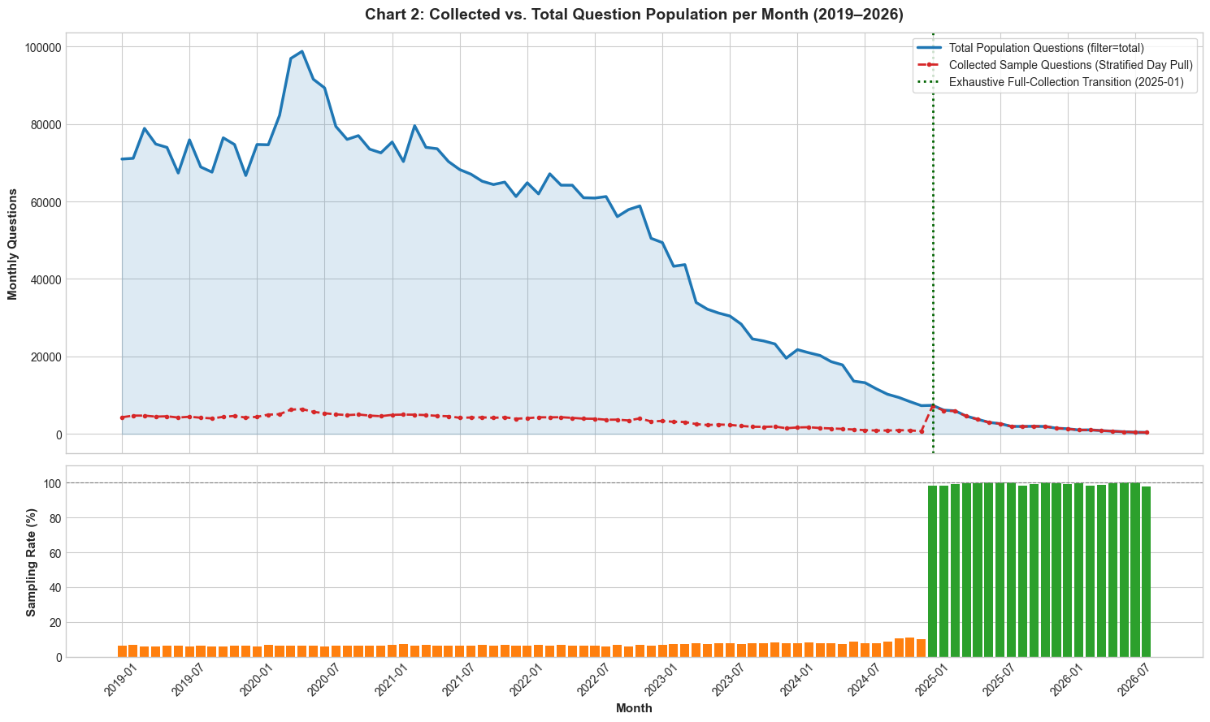
02 / DATA COLLECTION
Two sampled days a month before 2025, every day after
2019 to 2024
One random weekday and one random weekend day per tag and month (seed 42).
Each question gets a weight: days of that type in the month divided by days sampled.
Example: a month with 22 weekdays and 8 weekend days. One sampled weekday stands for 22 days of questions, one sampled weekend day for 8.
2025 to 2026
Every question is collected, so the weight is 1.
What it means: the sample is cheap but safe. Yearly volume estimated from it is within about 2% of the complete counts.
Stack Overflow in the AI Era
6
Notes:
Collecting all four million questions would have exceeded the API limits, so before 2025 we sampled one random weekday and one random weekend day per tag and month, and gave each question a weight that restores the real mix of days. From January 2025 volume is low enough to collect everything. The chart shows the sampling rate jumping from about seven percent to one hundred percent.

Slide 7
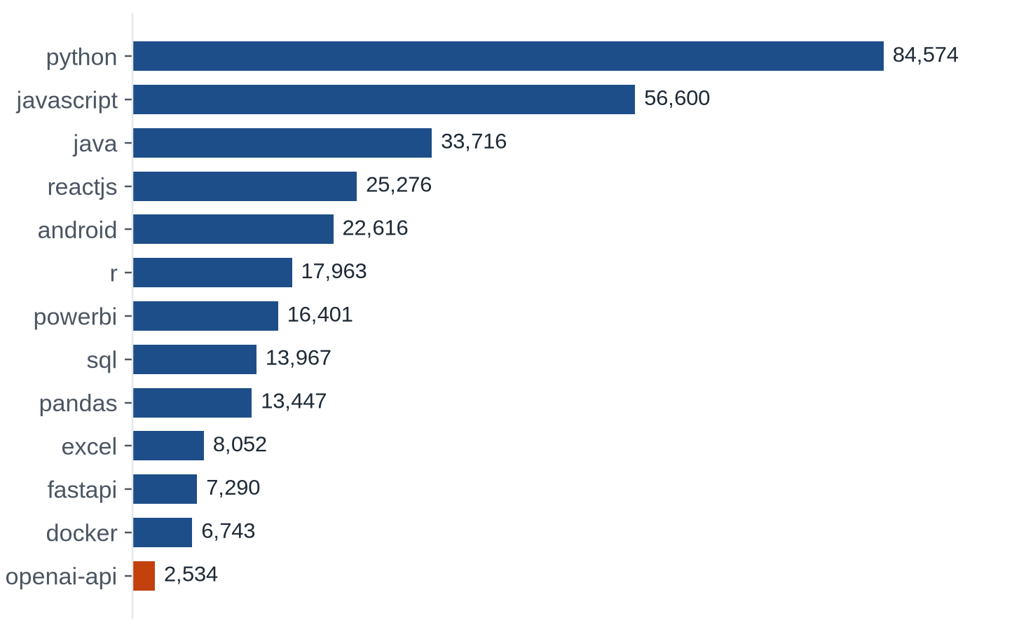
02 / THE DATASET
Python and JavaScript make up almost half of the 13 tags
Collected questions per tag
5,600
weekly counts
14 series (13 tags and the whole site) over 400 weeks, with no missing weeks. They drive every volume chart.
46%
of rows are Python or JavaScript
openai-api is our AI contrast tag. Its history starts in 2023, so we use it only for contrast.
Why these tags: they are popular and varied, so the results are not about one language.
Stack Overflow in the AI Era
7
Notes:
We chose popular and varied tags: general-purpose languages, data tools, frameworks, and one AI tag, openai-api, as a contrast. That tag's history only starts in 2023, so it shows topic and volume contrast, nothing more. Alongside the sampled records we collected the complete weekly question counts for every tag and for the whole site.

Slide 8
02 / VERIFICATION
Our counts match Stack Exchange's own tool to within 0.01%
207,204
1,336,266
questions in March 2014
questions in 2022
The all-time monthly peak.
The last full year before ChatGPT.
108,981
1,442
questions in 2025
questions in July 2026
A fall of 91.8% from 2022.
99.3% below the 2014 peak.
How we checked: we queried Stack Exchange Data Explorer for several tags and compared its monthly totals with our weekly counts. They agree within 0.01%. These are the only headline numbers we quote.
Stack Overflow in the AI Era
8
Notes:
To be sure the population counts are right, we checked them against Stack Exchange Data Explorer queries. The monthly sums match within 0.01 percent. These verified figures are the only headline numbers we use: a peak of about 207 thousand questions in March 2014, 1.34 million in 2022, 109 thousand in 2025 and 1,442 in July 2026.

Slide 9
03 / CLEANING
Five cleaning steps turned raw records into one clean table
1
2
3
4
5
Merge
Timestamps
Split the HTML
Missing values
Invalid posts
7,147 questions carried two selected tags. We kept one row for each.
Converted to UTC and checked: no answer before its question, nothing outside the window.
Plain text and code are separated. We count code blocks and flag error text.
No accepted answer means target 0. Deleted askers get a flag and an imputed age.
Empty, mostly non-English or spam posts are removed. Very long bodies are capped.
302,032
8,462
220,943
rows joined with answers and asker details
enrichment API calls, none failed
asker records, IDs hashed on arrival
Where to look: src/cleaning.py and notebooks/02_cleaning.ipynb. Every step records what it changed, so the before and after numbers come from the code.
Stack Overflow in the AI Era
9
Notes:
We first fetched the answer and asker details we were missing: over eight thousand batched API calls, none failed, with user IDs hashed straight away. Then five cleaning steps: merge and remove duplicates, convert timestamps, split the HTML into text and code, handle missing values, and check for invalid or extreme posts.

Slide 10
03 / CLEANING
We kept every unresolved question, because they are the point
What we found
What we did
Why
171,932 questions with no accepted answer
Gave them target 0 instead of dropping them
It is a real outcome. Dropping them would remove every unresolved question.
6,319 deleted askers (2.1%) with no account date
Used the median age before 2025 (543 days) and added a flag
Only training-period data, so nothing leaks from later.
7,147 questions with two selected tags
Kept one row and the smaller sampling weight
The more cautious estimate of how many real questions it stands for.
303 extremely long bodies
Capped them at the 99.9th percentile
Keeps the question without letting it dominate.
6 mostly non-English posts
Removed them
Nothing to model. Decided without looking at the outcome.
Also: the raw HTML body is not in the shared table (316 MB is over GitHub's file limit). plain_body and code_text are kept.
Stack Overflow in the AI Era
10
Notes:
The key rule: no row is removed because of its outcome. A question without an accepted answer is a real result, so it gets target zero rather than being dropped. The only imputation is the asker's account age, using the median from before 2025 so nothing from the test period leaks in, and a flag keeps the imputed rows visible.

Slide 11
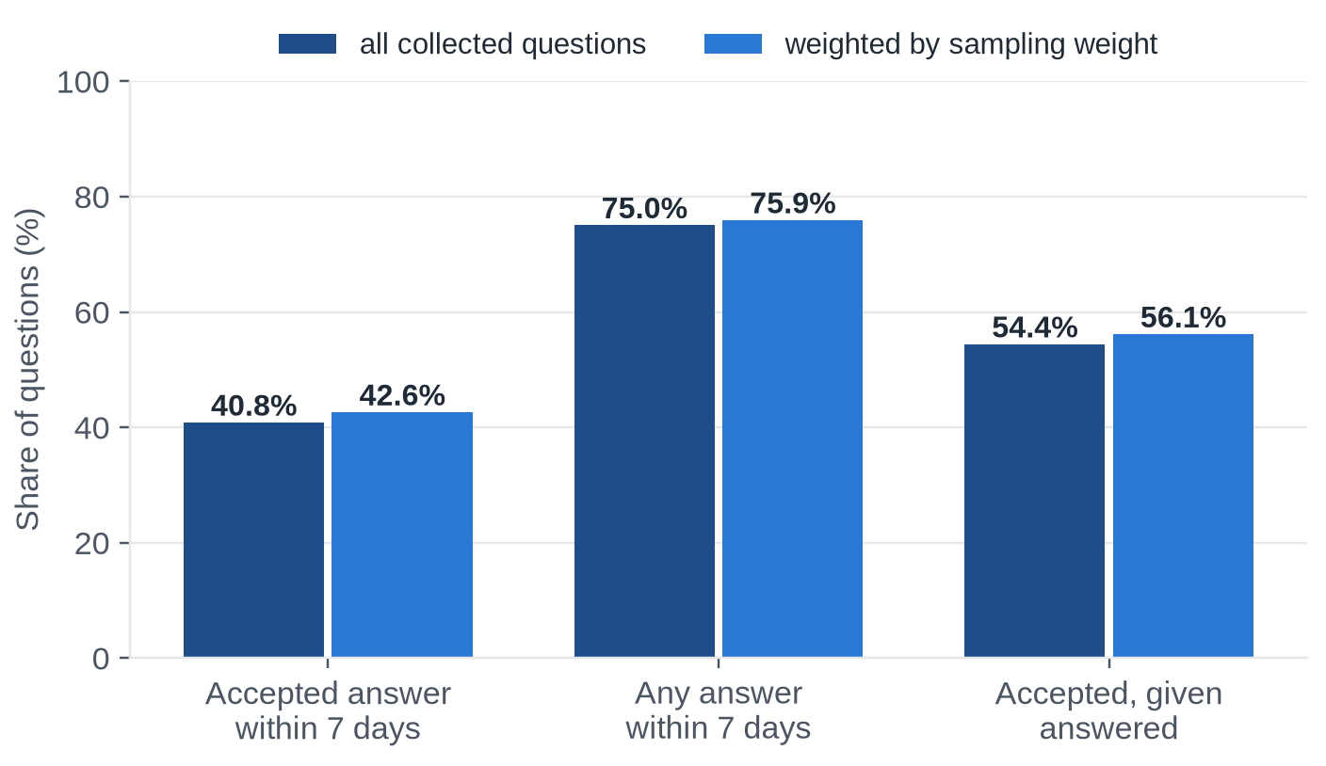
03 / TARGETS
41% of questions get an accepted answer within a week
Before and after cleaning
The outcomes we predict
Step
Rows
Rows collected
309,179
After merging duplicates
302,032
After removing invalid posts
302,026
Immature labels dropped
0
The newest question is 33 days old, so every label has had at least 30 days to form.
What it means: the main outcome is the minority, so we judge models with PR-AUC and the share resolved, not with accuracy.
Stack Overflow in the AI Era
11
Notes:
From 309,179 collected rows, merging duplicates leaves 302,032 and removing six invalid posts leaves 302,026. Our main outcome, an accepted answer within 168 hours, is positive for 41 percent of questions. The secondary outcome, any answer within a week, is 75 percent. Among questions that were answered, 54 percent also got an accepted answer. We drop questions younger than 30 days so every label has had time to form; none were that recent.

Slide 12
03 / ROBUSTNESS
The sample does not bend the trends, but it has limits
about 2%
0.2-0.3 pts
137 of 1,168
gap in yearly volume
change with a second seed
thin tag-months
Between the sampled estimate and the complete counts.
In the overall resolved rate for sql and excel.
Fewer than 30 sampled questions each, so they are flagged and greyed out.
Monthly volume from the sample is noisy (mean error 7.1%), so volume charts use the complete weekly counts.
Weighted and unweighted yearly rates differ by under 1 percentage point, but weights are still used for every monthly rate.
A target of 0 mixes 'no good answer' with 'the asker never came back to accept'. We treat that as a limit of using acceptance.
What it means: trends are safe to read from the weekly counts and weighted monthly rates, and the limits are written down.
Stack Overflow in the AI Era
12
Notes:
Sampling is a risk, so we tested it. Yearly volumes estimated from the sample are within about two percent of the complete counts. A second random seed changes the overall resolution rate by only a quarter of a percentage point. The limits: monthly estimates from the sample are noisy, so every volume chart uses the complete weekly counts, and a few small tags have thin months.

Slide 13
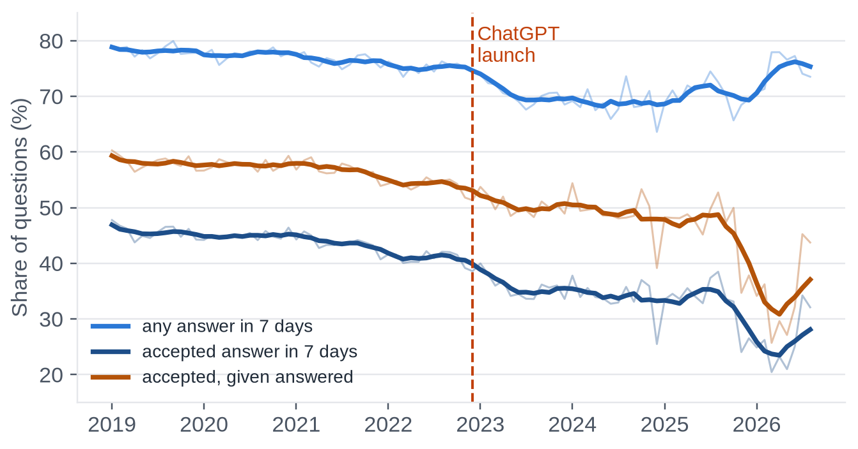
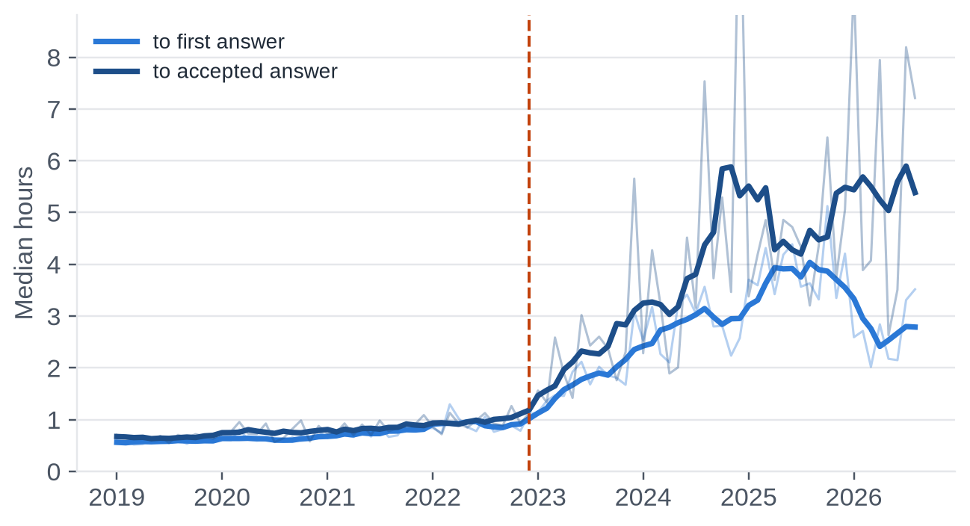
04 / WHAT THE DATA SHOWS
Since late 2022 fewer questions get resolved, and answers come slower
Share of questions resolved or answered within 7 days
Median time to an answer (hours)
Before → after November 2022 (averages weighted by estimated questions)
44% → 36%
77% → 71%
57% → 50%
0.8 h → 2.7 h
resolved within 7 days
answered at all
accepted, given answered
median time to accepted answer
Stack Overflow in the AI Era
13
Notes:
Before November 2022 about 44 percent of questions were resolved within a week. Since then it is about 36 percent. The share that get any answer also dropped, from 77 to 71 percent, and the median time to an accepted answer grew from under an hour to close to three hours. We say these changes are associated with that period; we cannot show cause.

Slide 14
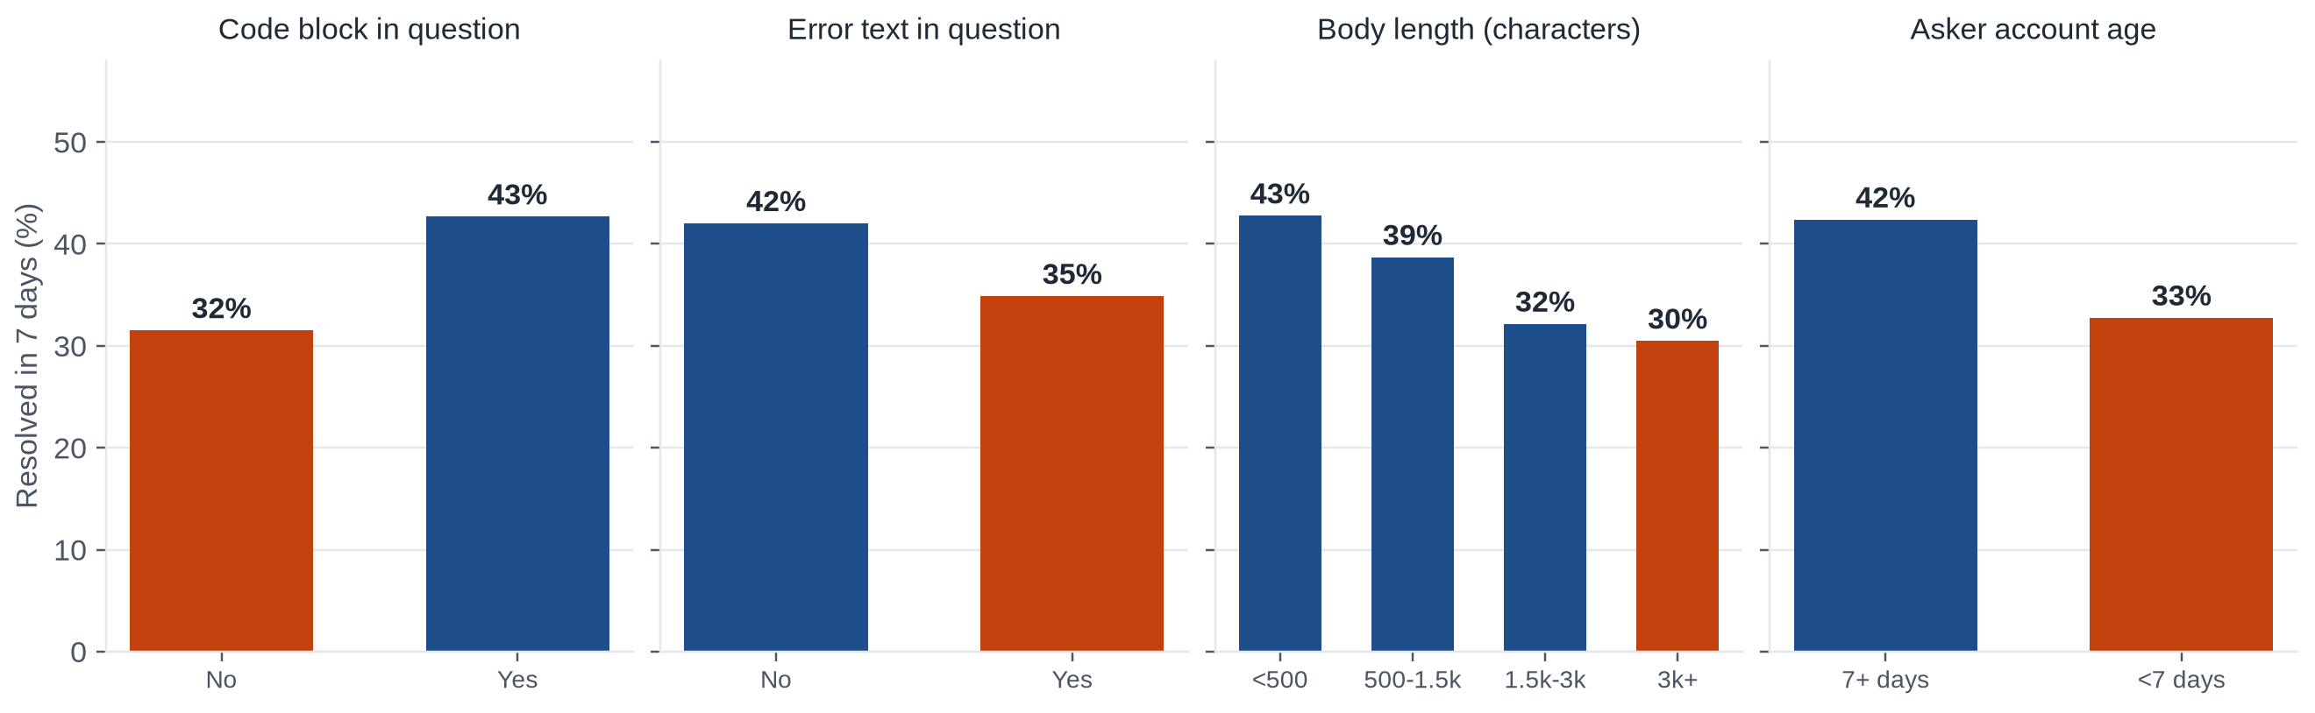
04 / WHAT THE DATA SHOWS
Code helps a question; error text and brand-new accounts do not
Share of questions resolved within 7 days, by question characteristic
Code blocks
43% are resolved with code and 32% without.
Shorter is better
Resolution falls steadily as the body gets longer.
Trust takes time
Accounts under 7 days: 33%. After a week it levels off near 42%.
Stack Overflow in the AI Era
14
Notes:
These are the question characteristics that move resolution. Questions with code blocks are resolved about 43 percent of the time against 32 percent without. Error text and long bodies go with lower resolution, and accounts under a week old resolve about 33 percent against 42 percent for established askers. All of these are known when the question is posted, so they can be used as features.

Slide 15
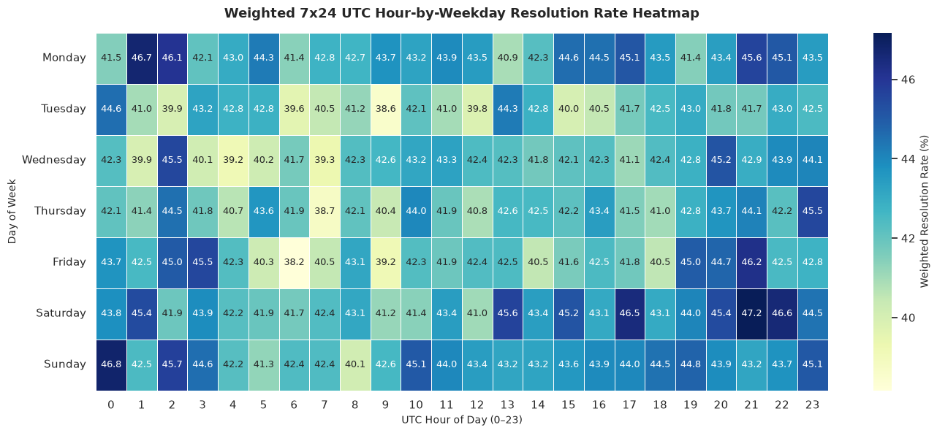
04 / WHAT THE DATA SHOWS
Resolution varies by only about nine points across the week
What the grid shows
The highest cell is late Saturday UTC, at 47.2%.
The lowest cells are near 38%, for example Friday 06:00 UTC.
The whole grid spans about nine points.
What it means: timing is a weak signal. We keep hour and weekday as features, but we do not expect them to drive the predictions.
Stack Overflow in the AI Era
15
Notes:
This heatmap shows the share of questions resolved within a week for every hour of every weekday, in UTC. The highest cell is late Saturday at 47 percent and the lowest are around 38 percent. The whole grid spans about nine points, so timing is a weak signal. We keep hour and weekday as features but do not expect them to drive the predictions.

Slide 16
04 / WHAT THE DATA SHOWS
Five findings from the EDA became features
Finding
What the EDA showed
Feature it became
Question structure
Code blocks, error text and body length matter
code_ratio, n_code_blocks, has_error_text, body_length
Account maturity
New accounts resolve less often
new_account, account_age_days
Timing
Weekend and time-of-day patterns
hour, weekday and month posted
Volume collapse
Questions fell about 90% after late 2022
tag volume in the past 4 weeks
Tags
Resolution differs by technology
one column per selected tag
One exclusion: answer_count has the strongest link to the outcome, yet it is only known after the question has been answered, so it is a leak and we do not use it.
Stack Overflow in the AI Era
16
Notes:
The exploration did not stay in the notebook. Each of the top five insights became a feature we used: structure of the question, account maturity, timing, volume shifts and the tags. Statistical tests agree that every feature is related to the outcome, but the effects are small, so we should not expect a very accurate model.

Slide 17
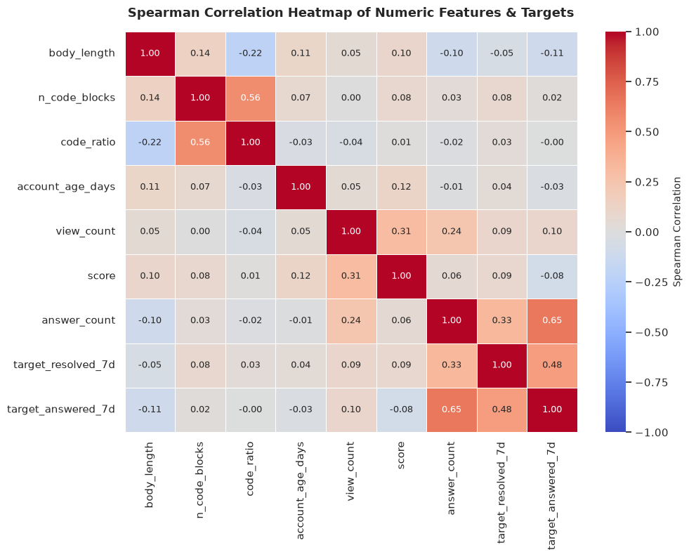
04 / WHAT THE DATA SHOWS
Most features are only weakly related to the outcome
Reading the heatmap
Code blocks (0.08), account age (0.04) and body length (-0.05) are all close to zero.
answer_count has the strongest link (0.33), but it is only known after the question is answered, so it is a leak.
The two outcomes are linked (0.48): answered questions are more likely to be accepted.
Tests give p < 0.001 for every feature, but the effects are small (Cramér's V below 0.11).
What it means: no single feature predicts resolution well, so we should expect a modest model.
Stack Overflow in the AI Era
17
Notes:
This is the Spearman correlation between the numeric features and the two outcomes. Code blocks, account age and body length are all close to zero. Answer count has the strongest link to the outcome, but it only exists after the question has been answered, so it is a leak and not a usable feature. Statistical tests agree that every feature is related to the outcome, but the effects are small.

Slide 18
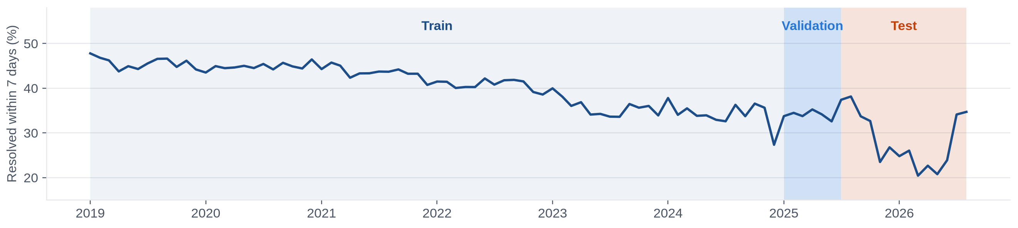
05 / FEATURES AND BASELINE
We test on the future, never on the past
Share of questions resolved within 7 days, by month, with the three periods
Train: Jan 2019 to Dec 2024
256,810 questions, 42.3% resolved
Validation: Jan to Jun 2025
28,132 questions, 34.1% resolved
Test: Jul 2025 to Jul 2026
16,695 questions, 29.7% resolved
Why not a random split? it would let the model peek at the future, and behaviour changed in late 2022. Inside the training period we use time-series folds: always train on the past and validate on the next block.
Stack Overflow in the AI Era
18
Notes:
A random split would let the model learn from 2024 to predict 2023, which no real system could do. So training is January 2019 to December 2024, validation is the first half of 2025, and the test period is July 2025 to July 2026. Notice the share of resolved questions falls from 42 to 30 percent across the three periods: the outcome itself drifts, which makes the test hard.

Slide 19
05 / FEATURES AND BASELINE
The model only sees what exists when a question is posted
Allowed
Question text: title and body length, code blocks, code share, error text, question word
Tags: how many, and one column per selected tag
Asker: account age, new-account flag, missing-age flag
Timing: hour, weekday and month posted (UTC)
Volume: tag volume in the 4 weeks before the posting week
Title wording, reduced with TF-IDF and SVD
Never allowed
score, views, answer count, is_answered
closed status and comments
current reputation
post_ai flag: constant in the test period, kept for analysis only
first_question: unreliable with sampled data
anything that contains the outcome, such as the time of the accepted answer
Rule of thumb: if it did not exist at the moment of posting, the model may not use it.
Stack Overflow in the AI Era
19
Notes:
The feature specification lists every candidate feature with its formula and whether it is available at posting time. On the other side is a forbidden list: score, views, answer count, closed status and similar fields only exist after the question has been out for a while. The post-AI flag and 'first question' are excluded on purpose too.

Slide 20
05 / FEATURES AND BASELINE
The checks found one real problem and no leaks
0
VIF > 1e15
0.07 / -0.05
leaky variables
perfect collinearity
strongest linear links
None of score, views or accepted-answer fields reached the feature set.
Caused by one-hot encoding the question word. Fixed by dropping one category.
Code blocks and error text. Every honest feature is weakly related to the outcome.
The two outcomes correlate at 0.48, as expected: answered questions are more likely to be accepted.
Dummy variable trap: keep one fewer one-hot column per categorical feature (the baseline drops 'none').
What it means: weak correlations mean a very accurate model is not realistic, so we judge by how much we beat guessing.
Stack Overflow in the AI Era
20
Notes:
We ran a correlation and variance-inflation check on the features. No leaky variables were found. The check did catch the dummy variable trap: one-hot encoding the leading question word made the columns perfectly collinear, with a variance inflation factor above ten to the fifteenth. Dropping one category removes it.

Slide 21
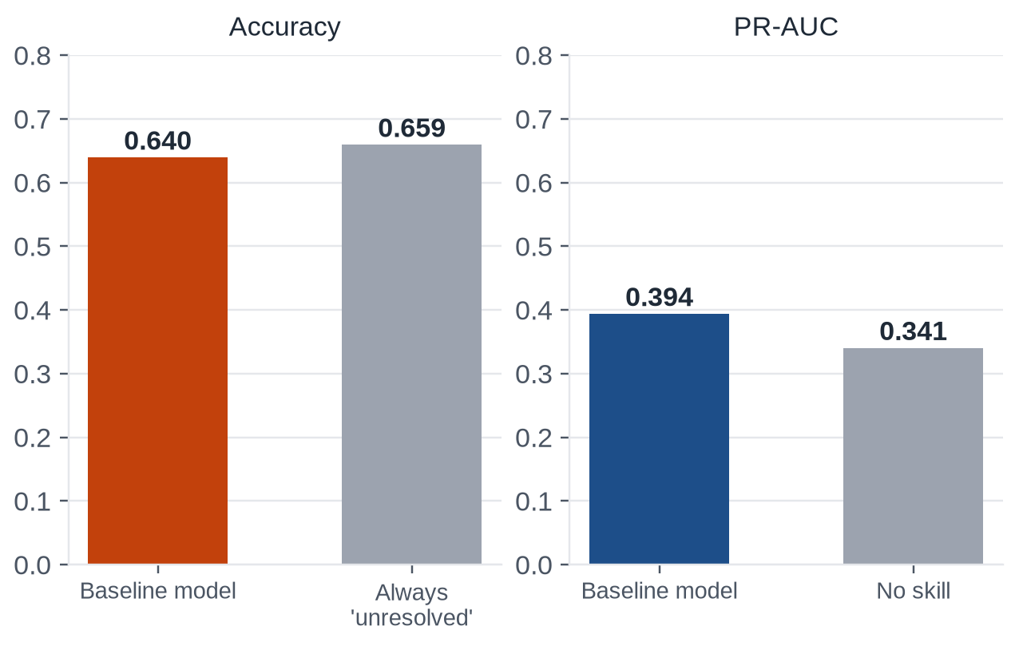
05 / FEATURES AND BASELINE
The baseline is 64% accurate, yet barely beats guessing
Baseline vs simple guessing (validation period)
0.640
0.423
accuracy
precision
0.160
0.579
recall
ROC-AUC
Accuracy is below always guessing 'unresolved' (about 0.66).
Recall of 0.16 means it misses most resolved questions at the default threshold.
What it means: this is the floor. The advanced models have to beat PR-AUC 0.394 and accuracy alone tells us nothing.
Stack Overflow in the AI Era
21
Notes:
The baseline is a plain logistic regression on the structured features. Accuracy 64 percent sounds acceptable, but only 34 percent of validation questions are resolved, so always predicting 'unresolved' is right 66 percent of the time. On a fairer metric, precision-recall AUC, the baseline scores 0.394 against 0.341 for no skill. That is the floor the advanced models have to beat.

Slide 22
06 / MODELS AND FINDINGS
We finished the feature set and trained three kinds of model
1. Features
2. Models
3. Rules
30 inputs, all known at posting time.
A guard rejects any outcome field.
Title wording adds +0.027 PR-AUC.
Logistic regression, random forest and XGBoost.
Class weights, and scale_pos_weight for XGBoost.
XGBoost trees chosen by early stopping (628 trees).
Tuning on date-based folds with a 7-day gap.
Threshold chosen on validation only.
Test period scored once.
Added to the baseline's features: tag volume from the complete weekly counts (past weeks only), body length, new-account and missing-age flags, one column per tag, and title wording (TF-IDF reduced to 100 components, fitted on training data only).
Where it ran: on Google Colab with a T4 GPU for XGBoost. All code and tests are in the repository.
Stack Overflow in the AI Era
22
Notes:
My part starts where the baseline stopped. I added the remaining features from the specification: tag volume in the four weeks before the posting week, tag columns, and title wording reduced with SVD. Preprocessing sits inside the model pipeline, so it is refit on training data only in every fold. Random forest and XGBoost are tuned on date-based folds that leave a seven-day gap, because a label is only known a week after posting.

Slide 23
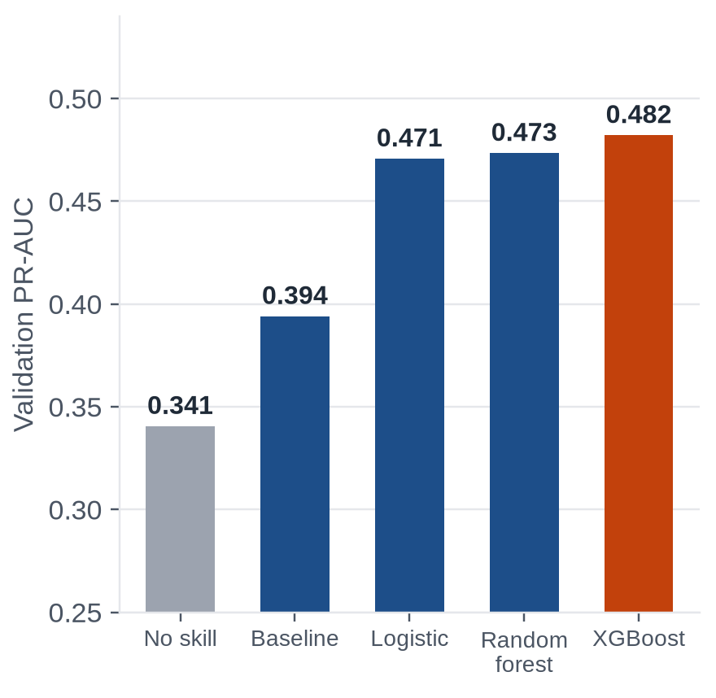
06 / MODELS AND FINDINGS
XGBoost wins, but only just
Model
Precision
Recall
F1
PR-AUC
ROC-AUC
Validation PR-AUC
Majority class
0.000
0.000
0.000
0.341
0.500
Logistic regression (baseline)
0.357
0.909
0.513
0.394
0.579
Logistic regression
0.389
0.808
0.525
0.471
0.636
Random forest
0.386
0.813
0.524
0.473
0.638
XGBoost
0.400
0.782
0.529
0.482
0.645
The share resolved in validation is 34%, so a no-skill ranking has PR-AUC 0.341.
We chose XGBoost with threshold 0.37, tuned for F1 on validation only.
What it means: the three real models differ by about 0.01. The gain over the baseline comes mostly from better features, not from a fancier model.
Stack Overflow in the AI Era
23
Notes:
On the validation period, the three real models are close. Logistic regression gets 0.471 precision-recall AUC, random forest 0.473 and XGBoost 0.482, against 0.341 for no skill and 0.394 for the baseline. XGBoost is chosen because it has the highest value on the threshold-free metric, and its decision threshold is tuned on validation only. The summary: gradient boosting is only slightly better than a well-built linear model.

Slide 24
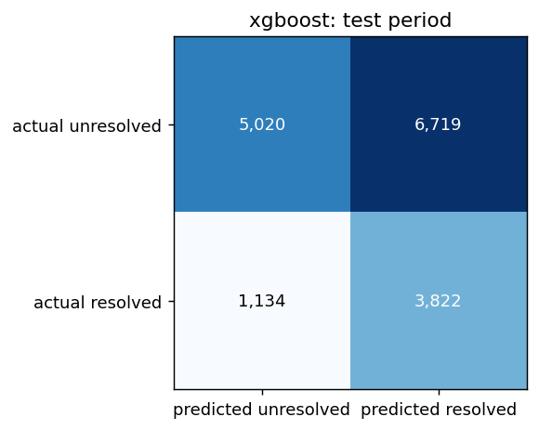
06 / MODELS AND FINDINGS
On the test period the model beats guessing, but not by much
Test confusion matrix
0.431
0.655
24.1%
PR-AUC
ROC-AUC
of unresolved caught
A no-skill ranking scores 0.297.
No skill is 0.500.
By flagging the lowest 20%. Chance: 20%.
Metric
Value
Meaning
Precision
0.363
of questions predicted resolved, the share that were
Recall
0.771
of resolved questions, the share we found
F1
0.493
balance of the two at the chosen threshold
Questions scored
16,695
29.7% of them resolved
What it means: the model finds most resolved questions (recall 0.77) but flags many unresolved ones too (precision 0.36). It helps prioritise; it cannot decide.
Stack Overflow in the AI Era
24
Notes:
The test period, July 2025 to July 2026, was scored exactly once, after the model and threshold were fixed on earlier data. A lock file stops a second run. The model reaches 0.43 precision-recall AUC where a no-skill ranking gets 0.30, and 0.655 ROC-AUC. If a manager flags the 20 percent of questions with the lowest predicted resolution, 24 percent of the unresolved ones are in that group, against 20 percent by chance.

Slide 25
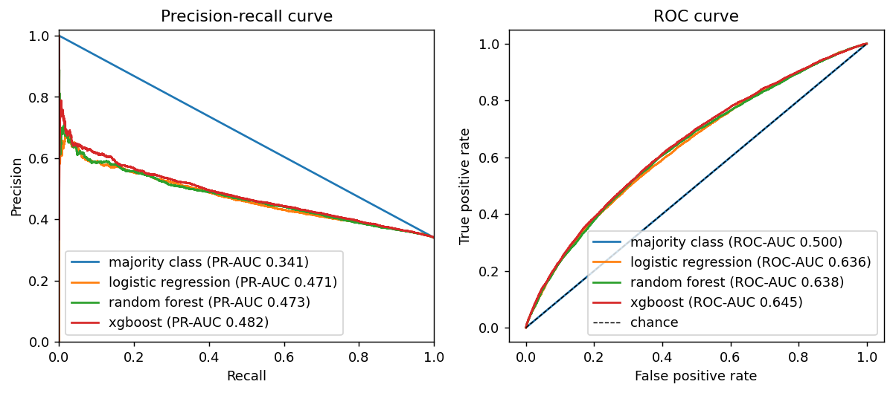
06 / MODELS AND FINDINGS
On the curves, the three real models are hard to tell apart
Validation period, all models
How to read them
Precision-recall: how many flagged questions are really resolved, as we flag more.
ROC: how well questions are ranked, at any threshold. The diagonal is chance.
What it means: the three real models are hard to tell apart, and all of them sit well below a perfect curve.
Stack Overflow in the AI Era
25
Notes:
These are the precision-recall and ROC curves for all four models on the validation period. The curves for the three real models lie close together and above the no-skill line, which is why the differences in the table are small. The no-skill line sits at the share of resolved questions for precision-recall and on the diagonal for ROC.

Slide 26
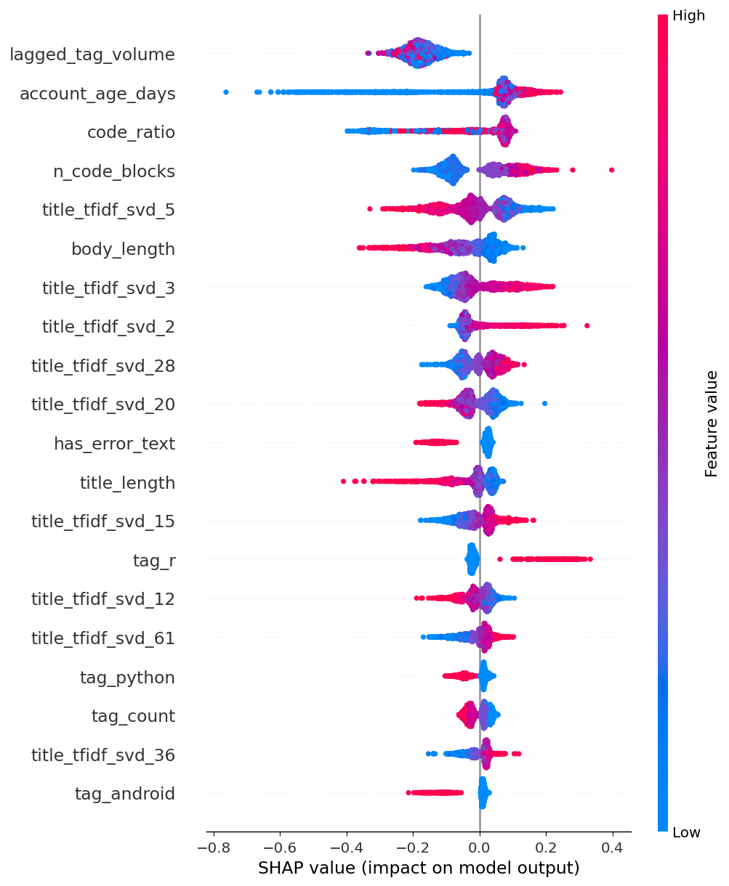
06 / MODELS AND FINDINGS
Account age, code and the tag's recent volume drive the predictions
How to read the SHAP plot
Brand-new accounts and questions with no code blocks are the least often resolved; the effect levels off for older accounts.
Resolution rises with some code, then falls again for questions that are almost all code.
Error text, longer titles and longer bodies are associated with fewer accepted answers in the test period; the r tag with more, python and android with fewer.
Tag volume stays in one narrow, low range in the test period (volume has fallen since 2022), so it stands in for the period and tag mix, not for the question itself.
Cross-check: the plain logistic regression gives the same signs for error text and new accounts, and for the pandas, r and sql tags (more resolved) against python and android (fewer).
Stack Overflow in the AI Era
26
Notes:
SHAP shows how much each feature pushes a question towards resolved or unresolved. Brand-new accounts and questions with no code are the least often resolved. Error text, longer titles and longer bodies go with fewer accepted answers in the test period. Tag volume stays in one narrow, low range in the test period, so it stands in for the period and tag mix and not for the question itself. The logistic regression coefficients agree on error text and new accounts.

Slide 27
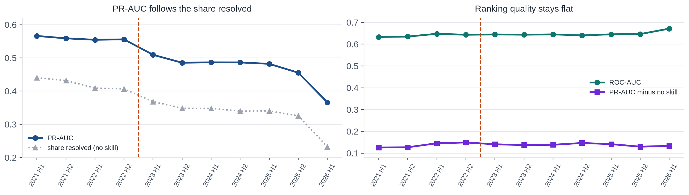
06 / MODELS AND FINDINGS
Ranking quality held up after November 2022; the resolution rate fell
Train on everything before each half-year, test on that half-year (2021 H1 to 2026 H1)
Before → after November 2022 (mean over the half-year windows)
0.64 → 0.65
0.56 → 0.47
42% → 33%
0.14 → 0.14
mean ROC-AUC
mean PR-AUC
share resolved
PR-AUC minus no skill
Stack Overflow in the AI Era
27
Notes:
The single test period is entirely after November 2022, so it cannot show what changed. Rolling-origin evaluation can: for each half-year we train on everything before it and test on that half-year. Precision-recall AUC falls from 0.56 to 0.47, but so does the share of resolved questions, from 42 to 33 percent, and PR-AUC depends on that share. ROC-AUC stays flat at 0.64 to 0.65 and PR-AUC minus the no-skill level is the same before and after. So the model's skill did not change; what changed is how often questions are resolved.

Slide 28
06 / MODELS AND FINDINGS
The same model ranks 'any answer in 7 days' about as well
Test period
Accepted answer
Any answer
Top features
Accepted answer
tag volume, account age, code share, code blocks
Any answer
body length, tag volume, title wording, code blocks
Share of questions positive
29.7%
71.4%
PR-AUC
0.431
0.830
ROC-AUC
0.655
0.667
Capture rate (lowest 20% flagged)
24.1%
32.4%
What it means: PR-AUC is not comparable across the two outcomes because their base rates differ, so ROC-AUC is the fair comparison. For 'any answer', the best F1 threshold flags almost everything, so we do not use F1 there.
Stack Overflow in the AI Era
28
Notes:
Acceptance depends on the asker coming back, so we repeated the analysis for the easier outcome: any answer within seven days. The model ranks that outcome about as well, with ROC-AUC 0.667 against 0.655. We compare ROC-AUC because the two outcomes have very different base rates, 71 percent against 30 percent. The top features differ in a sensible way: body length matters more for getting any answer, account age and code for getting an accepted one.

Slide 29
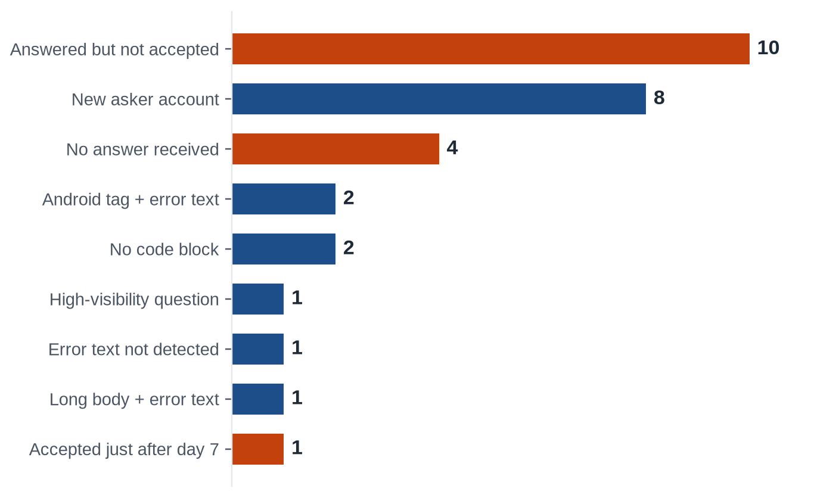
06 / MODELS AND FINDINGS
The model's confident mistakes are mostly about the asker
Main reason for each of the 30 confident errors
What it tells us
Acceptance depends on the asker, which the model cannot see at posting time.
New askers who do come back are resolved fast: 7 of 8 within 4 hours.
The error-text pattern is case sensitive, so one miss was a feature gap.
A question's visibility (41,576 views for one) is not known at posting time.
false positives
false negatives
How we did it: each question was read at its link. Only titles are shared, and each links to the original (CC BY-SA 4.0).
Stack Overflow in the AI Era
29
Notes:
To understand the mistakes, I took the 30 most confident errors, 15 false positives and 15 false negatives, and read each question. Most false positives were answered, often within minutes, but the asker never accepted an answer, which nothing known at posting time can predict. Most false negatives came from accounts created the same day that returned and got an accepted answer within hours. One miss came from a feature limit: the error-text pattern is case sensitive.

Slide 30
06 / MODELS AND FINDINGS
How a forum manager could use the model
Prioritise
Ask for code
Watch the rate
Keep it fresh
Flag the 20% of questions with the lowest predicted resolution. It catches 24% of the unresolved ones, against 20% by chance.
More code goes with more accepted answers. Do not assume error text helps: it goes with fewer.
Resolution fell from about 42% to 33% while ranking quality stayed flat. Track the rate itself.
Behaviour shifts over time. Refresh the model regularly and keep scoring on the newest months.
Limits
An accepted answer within 7 days is a strict proxy for resolved: it depends on the asker coming back.
The gain over a no-skill ranking is modest, and the three real models differ only slightly.
Recent data (2025 onwards) is smaller than the sampled early years, only 13 tags are covered, and we say 'associated with', never 'caused by'.
Stack Overflow in the AI Era
30
Notes:
The model is useful for prioritising, not deciding. Flagging the lowest-scored fifth of questions catches 24 percent of the unresolved ones against 20 percent by chance. Askers who add code and who have established accounts are resolved more often. The resolution rate itself has fallen, so it should be tracked. Limits: acceptance is only a proxy for resolved, recent data is smaller than the sampled early years, and we say 'associated with', never 'caused by'.

Slide 31
07 / HOW WE WORKED
We worked from one shared board and one repository
1. Plan
2. Build
3. Reproduce
Every task had an owner, a stage and a place for evidence.
Stages ran from Backlog and To Do through In Progress and Review/Testing to Completed.
Delays were raised early so work could be reassigned.
One branch for each piece of work.
Commit messages start with the number of the task they belong to.
A partner reviews each change before it is merged.
Notebooks and scripts rebuild every table and chart.
The cleaned dataset is too large for GitHub and is shared on the team drive.
Tests cover the collection, cleaning, feature and evaluation code.
What it means: anyone can trace a result back to the code that made it and to the person who reviewed it.
Stack Overflow in the AI Era
31
Notes:
Everything was planned on one GitHub Projects board and built in one repository. Each piece of work had an owner and a stage, changes were reviewed by a partner before they were merged, and the notebooks and scripts rebuild every result.

Slide 32
07 / HOW WE WORKED
What each of us did
Adhikkesh S K
CB.SC.U4CSE23101
Built and tested the prediction models. Completed the feature set with tag volume and title wording, trained logistic regression, random forest and XGBoost, tuned them on time-based folds, scored the test period once, and explained the results with SHAP, a before-and-after check around November 2022, a second outcome and an error analysis.
Abhinav Gopalakrishnan
CB.SC.U4CSE23201
Built the data foundation. Wrote the API collection client, designed the sampling, collected the questions and the complete weekly counts, checked them against Stack Exchange Data Explorer, and wrote the dataset documentation and the combined notebook.
Rishiikesh
CB.SC.U4CSE23236
Enriched and cleaned the data. Fetched answer and asker details, merged and cleaned everything into one table, built both 7-day outcomes, and tested how far the sampling could bend the results.
Akshay Krishna
CB.SC.U4CSE23403
Framed the problem and explored the data. Wrote the problem statement and research question, built the event timeline, made the charts and statistical checks on resolution, and turned the findings into suggestions for the features.
Nishanth Konchada
CB.SC.U4CSE23523
Prepared the ground for modelling. Built the time-based split and validation folds, the feature pipeline, the leakage and multicollinearity checks, and the logistic regression baseline.
Together: each of us led one stage and reviewed a partner's work, so everyone has seen the code they depend on.
Stack Overflow in the AI Era
32
Notes:
Each of us led one stage of the pipeline and reviewed a partner's work, so everyone has seen the code they depend on. The individual contribution summaries link every claim to its evidence.

Slide 33
08 / WHAT COMES NEXT
Review 2: topics, technology forecasts and a stronger model
Topics and complexity
Technology forecasts
A stronger model
Topic modelling on titles: which topics do developers still bring to a human community?
Did question complexity change around AI adoption?
Forecast weekly volume per tag from the complete counts.
Which tags keep declining and which stay stable? How should support change?
Asker-history features, if we can get them without leakage.
A case-insensitive error-text feature, and calibrated scores.
One shared feature pipeline, and a saved final model.
In short: Review 1 answered 'can we predict resolution'. Review 2 asks 'what do people still ask, and where is it going'.
Stack Overflow in the AI Era
33
Notes:
For Review 2 we move from whether a question gets resolved to what people still ask and which technologies keep declining. On the modelling side, the error analysis tells us what to improve: asker history, a better error-text feature, and calibration of the scores.

Slide 34
08 / SUBMISSIONS
Everything is in one repository and can be re-run
01
Notebooks
notebooks/
01_collection, 02_cleaning, 03_eda, 04_features, 05_models, 06_evaluation, and the combined review1_main
02
Data documentation
docs/
dataset_documentation, data_dictionary, sampling_limitations, problem_statement
03
Project board
GitHub Projects
owners, stages, evidence and history for every task
04
Reports
reports/review1/
contribution summaries, viva questions, model results and figures
Repository: github.com/Abhinav-Gopalakrishnan/stackoverflow-ai-era
Stack Overflow in the AI Era
34
Notes:
All deliverables are in the repository: the notebooks, the data documentation, the board and the code with its tests. The cleaned dataset is too large for GitHub and is shared on the team drive; the notebooks and scripts say exactly how to rebuild every result.

Slide 35
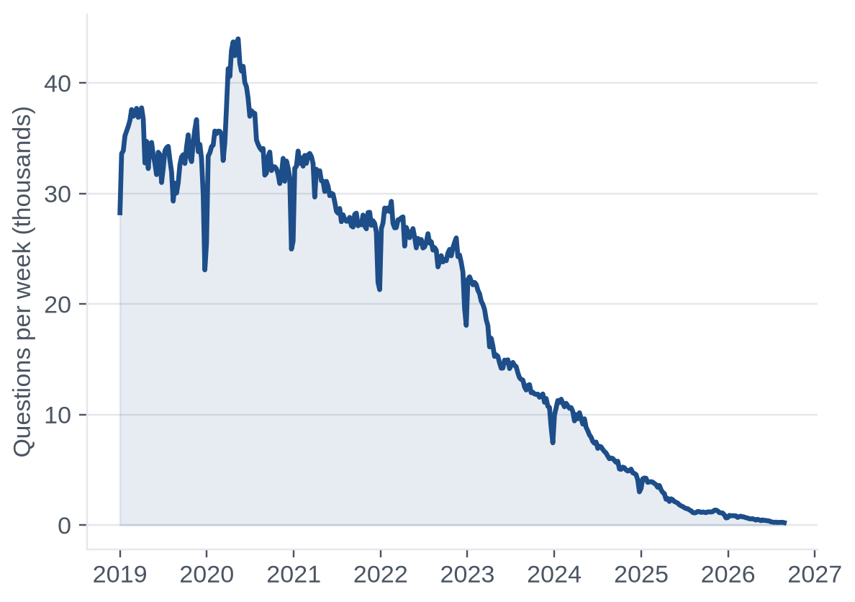
Thank you · Questions?
Which Stack Overflow questions still get an answer in the age of AI?
Repository github.com/Abhinav-Gopalakrishnan/stackoverflow-ai-era
Board github.com/users/Abhinav-Gopalakrishnan/projects/3
Adhikkesh S K CB.SC.U4CSE23101
Abhinav Gopalakrishnan CB.SC.U4CSE23201
Rishiikesh CB.SC.U4CSE23236
Akshay Krishna CB.SC.U4CSE23403
Nishanth Konchada CB.SC.U4CSE23523
Notes:
Thank you. We are happy to take questions on any part of the pipeline.

